Slide 1
INCOTERMS OVERVIEW Workshop
Air Carrier Purchasing Conference
2024

Slide 2
Jason Dickstein
Aviation attorney since 1992
General Counsel to the Aviation Suppliers Association since 1997
Our law firm represents and counsels air carriers, manufacturers, repair stations and distributors
Advise businesses on transactions in aircraft, engines, inventories and parts

Slide 3
Today’s Agenda
What are Incoterms?
Examination of key terms
Comparison of Incoterms
Delivery
Risk of loss
Export Clearance
Tips on using Incoterms

Slide 4
Introduction to Incoterms
Incoterms are commercial terms designed to facilitate international trade
“Incoterms” is a portmanteau of “international commercial terms” and is a registered trademark of the International Chamber of Commerce
These are commercial terms
Not regulatory nor statutory
No legal effect until you use them
Updated every ten years (Incoterms 2020 now in effect)
Purpose is to provide consistency in international trade among diverse jurisdictions

Slide 5
Incoterms are “Code Words” that Specify Terms and Conditions
What do Incoterms do?
Specify (some) legal obligations of seller and buyer
Specify when RISK OF LOSS passes from seller to buyer
What do Incoterms NOT do?
DO NOT determine when TITLE passes
Do not establish all rights and remedies under contract
Most do not address insurance issues (and not completely)
Do not address terms of payment, credit terms, other contract issues
Incoterms are designed primarily to establish when risk of loss passes and the responsibilities of seller and buyer for goods in transit

Slide 6
How do I use Incoterms?
They can arise in a contract
“Not later than the Delivery Date specified in paragraph 11(a) of this Agreement, the Selling Party shall deliver the Goods to the Buyer DAP (Incoterms 2020) the address identified in paragraph 12(b) of this Agreement.”

Slide 7
How do I use Incoterms?
They can arise in a contract
They can arise in agreed-upon terms and conditions
“The delivery terms for each sales transaction subject to these terms and conditions shall be EXW (Incoterms 2020) Seller’s premises at the address specified in clause 11(a) of these terms and conditions.”

Slide 8
How do I use Incoterms?
They can arise in a contract
They can arise in agreed-upon terms and conditions
They can arise in commercial documents like purchase orders
Purchase Order
Deliver to Jason’s Aircraft Parts 2233 Wisconsin Ave NW Washington, DC 20007 |  | Purchased from Joe’s White House 1600 Pennsylvania Ave, NW Washington, DC 20044
Deliver By: | Terms: DAP (Incoterms 2020) Jason’s Aircraft Parts
August 30, 2024
P/N | S/N | Qty | @ Price

Slide 9
Introduction to 7 Incoterms for Land and Air Carriage
Any Transport Mode
Ex Works (EXW)
Free Carrier (FCA)
Carriage Paid To (CPT)
Carriage and Insurance Paid To (CIP)
Delivered at Place Unloaded (DPU)
Delivered at Place (DAP)
Delivered Duty Paid (DDP)
Sea and Inland Waterway Only
Free Alongside Ship (FAS)
Free on Board (FOB)
Cost and Freight (CFR)
Cost Insurance and Freight (CIF)

Slide 10
We Will Skip the Maritime Terms
Any Transport Mode
Ex Works (EXW)
Free Carrier (FCA)
Carriage Paid To (CPT)
Carriage and Insurance Paid To (CIP)
Delivered at Place Unloaded (DPU)
Delivered at Place (DAP)
Delivered Duty Paid (DDP)
Sea and Inland Waterway Only
Free Alongside Ship (FAS)
Free on Board (FOB)
Cost and Freight (CFR)
Cost Insurance and Freight (CIF)

Slide 11
Term-by-Term Discussion

Slide 12
Ex Works (EXW)
Seller responsibilities
Make goods available at specified location
Buyer responsibilities
Loading goods (even at Seller’s facility)
Export compliance (when applicable)
All transportation after loading
Any additional costs (e.g. insurance, import duties)
Insurance: Seller is not obligated to insure goods

Slide 13
Exercise
You (Seller) sell an avionics package to Buyer, ex works [Incoterms 2020] your shipping dock, with 30 day terms
You properly package it and make it available on your shipping dock for pick-up, with notice to the Buyer
The carrier picks up the avionics and departs with them
Immediately after departure, a major accident results in a vehicle fire that destroys the avionics
The avionics never get to Buyer
When the 30 days terms come due, does Buyer have to pay Seller?

Slide 14
Exercise
You (Seller) sell an avionics package to Buyer, ex works [Incoterms 2020] your shipping dock, with 30 day terms
You properly package it and make it available on your shipping dock for pick-up, with notice to the Buyer
The carrier picks up the avionics and departs with them
Immediately after departure, a major accident results in a vehicle fire that destroys the avionics
The avionics never get to Buyer
When the 30 days terms come due, does Buyer have to pay Seller?
Yes, under the Ex Works provisions, risk of loss passed when the goods were placed on the shipping dock and notification provided

Slide 15
Free Carrier (FCA)
Seller responsibilities
Make goods available at specified location
Arrange for transportation to that specified location
Load goods at Seller’s risk
Export clearance
Buyer responsibilities
Assumes risk after delivery to specified location
All transportation after delivery to specified location
Any additional costs (e.g., insurance, import duties)
Insurance: Seller is not obligated to insure goods

Slide 16
Carriage Paid To (CPT)
Seller responsibilities
Arranges transportation to specified location and hand the goods to the carrier
Pays transportation to specified location (may or may not include certain fees)
Export compliance
Buyer responsibilities
Assumes risk when goods delivered to carrier
Any additional costs (e.g., insurance, import duties)
Insurance: Seller is not obligated to insure goods

Slide 17
Carriage and Insurance Paid To (CIP)
Seller responsibilities
Arranges transportation to specified location and hand the goods to the carrier
Pays transportation to specified location (may or may not include certain fees)
Export compliance
Buyer responsibilities
Assumes risk when goods delivered to carrier (but covered by insurance)
Any additional costs (e.g., import duties)
Additional insurance if desired
Insurance: Seller must also insure goods to specified location

Slide 18
Delivered at Place (DAP)
Seller responsibilities
Arrange carriage and delivery to specified location
Make available for unloading
Buyer responsibilities
Risk transfers when goods available for unloading (unloading is at Buyer’s risk)
Any additional costs (e.g., import duties)
Insurance: Seller is not obligated to insure goods

Slide 19
Delivered Duty Paid (DDP)
Seller responsibilities
Arrange carriage and delivery to specified location
Make available for unloading
Pay applicable import taxes and duties and ensure import clearance
Buyer responsibilities
Risk transfers when goods available for unloading (unloading is at Buyer’s risk)
Insurance: Seller is not obligated to insure goods

Slide 20
Delivered at Place Unloaded (DPU)
Seller responsibilities
Arrange carriage and delivery to specified location, including unloading
Buyer responsibilities
Risk transfers when unloaded
Any additional costs (e.g., import duties)
Insurance: Seller is not obligated to insure goods (although still responsible until unloaded)
Note: This rule was called Delivered at Terminal (DAT) in Incoterms 2010

Slide 21
Delivery Terms
 | EXW | FCA | CPT | CIP | DAP | DDP | DPU
Delivery | Placed at a named spot for buyer’s retrieval, ready to be loaded | Placed at a named spot for buyer’s retrieval; if that spot is the seller’s premises then delivery is complete upon loading | Provided to the named carrier or by procuring goods handed to carrier | Provided to the named carrier or by procuring goods handed to carrier | Arrived at a named spot, ready to be unloaded | Arrived at a named spot, ready to be unloaded | Arrived at a named spot, unloaded, and ready to be retrieved by buyer
When Does Buyer Take Delivery? | When “delivered” and notice given to Buyer | When “delivered;” Buyer required to receive the goods from carrier at destination | When “delivered;” Buyer required to receive the goods from carrier at destination | When “delivered” | When “delivered” | When “delivered” | When “delivered”

Slide 22
Transfer of Risk / Export Clearance
 | EXW | FCA | CPT | CIP | DAP | DDP | DPU
Risk of Loss Transfers | Buyer bears all risk of loss from “delivery” | Buyer bears all risk of loss from “delivery;” if carrier fails to pick up goods, then buyer bears all risks of identified goods after the pick-up period has ended | Buyer bears all risk of loss from “delivery;” if Buyer fails to fulfill its export or import clearance obligations, then it bears all risks of loss; Buyer must typically provide notice of named destination
Export Clearance | Buyer’s responsibility; Seller assists at Buyer’s request, risk and cost | Seller’s responsibility; Buyer assists at Seller’s request, risk and cost

Slide 23
Exercise
Seller and Buyer agree to buy an engine
They agree that risk of loss should pass when the engine arrives at the Seller’s facility, and that risk of unloading loss should be borne by the buyer
Which incoterm should they reference?

Slide 24
Exercise
Seller and Buyer agree to buy an engine
They agree that risk of loss should pass when the engine arrives at the Seller’s facility, and that risk of unloading loss should be borne by the buyer
Which incoterm should they reference?
DAP or DDP
The difference is that under DDP, Seller is responsible for import tariffs and import clearance

Slide 25
Incoterms 2010 vs. Incoterms 2020
Some minor changes
Delivered at Terminal (DAT) changed to Delivered at Place Unloaded (DPU)
Practical rule is the same
Carriage and Insurance Paid (CIP) now requires insurance for fire/explosion, sinking, jettison, breakage/theft, washing overboard. Underlined coverage was new for 2020.
Cost Insurance and Freight requires only fire/explosion, sinking, jettison (unchanged).
You can use whatever version you want but you must specify
E.g., EXW 2010; FCA 2020
The ability to rely on prior terms can be useful if you have standard terms you are already comfortable with and have procedures in place based on your existing standard terms

Slide 26
Uniform Commercial Code (UCC)
Incoterms can be used for purely domestic shipments as well, because they are commercial in nature
The UCC is unique to the U.S. and is adopted at the state level
UCC terms may be cited in contracts but the UCC also has the force of law where it is adopted.
UCC is not federal law but uniformity results in consistency of interpretation
BEWARE OF SIMILAR TERMS: FOB has different meanings and uses under UCC and Incoterms.
Distinguish by always citing to Incoterms when they are to apply

Slide 27
Uniform Commercial Code (UCC)
UCC F.O.B. can apply to any form of carriage (UCC § 2-319(1)(c))
FOB [location where risk passes]
Manner, time, and place of delivery are specified by agreement
Requires Seller to deliver at named destination
F.O.B. (incoterms 2020) requires Seller to load on a maritime vessel – risk passes upon loading
In both uses of FOB the Seller is required to load at its own risk. FOB Incoterms is used only for vessels, so if using FOB be sure to distinguish which one you are using
Be careful! It is easy to make mistakes here.

Slide 28
Uniform Commercial Code (UCC)
UCC also includes Free Alongside Vessel (F.A.S.), Cost Insurance and Freight (C.I.F.), and Cost and Freight (C & F).
These terms are similar to Incoterms but not identical
UCC C.I.F. may require war risk insurance in addition to other coverages; Incoterms does not
Important to review and specify what the terms do and do not cover
Remember, UCC requirements will typically apply to transactions in the United States even if they are not included in the agreement unless otherwise specified; thus you need to be specific if you do not intend the UCC to apply to your sale of goods

Slide 29
Practice Tips
Buy a copy of Incoterms or hire a lawyer who understands Incoterms
Remember to specify the location for your incoterms (don’t just write “EXW”). This is typically necessary to identify where risk passes

Slide 30
Considerations when Negotiating Terms
For domestic transactions you can use Incoterms for convenience, but you are not required; UCC provisions will apply unless specifically addressed
For international transactions you can use Incoterms, but you are not required
Has the benefit of (relatively) uniform interpretation
Discuss with your transaction partner what the risks are, how they are divided, and how costs are to be allocated
This can help you choose the Incoterm that applies to your transaction
If you want to diverge from an Incoterm that is referenced, then be sure to include specific clauses detailing the responsibilities that diverge from the selected term

Slide 31
Considerations when Negotiating Terms
Risk of Loss Transfer considerations
Where do you expect it to pass?
History with/reputation of Seller
Your exposure
Remember: Ex Works (EXW) means the buyer is at risk as soon as (1) the goods are made available for pick-up and (2) the Buyer is notified

Slide 32
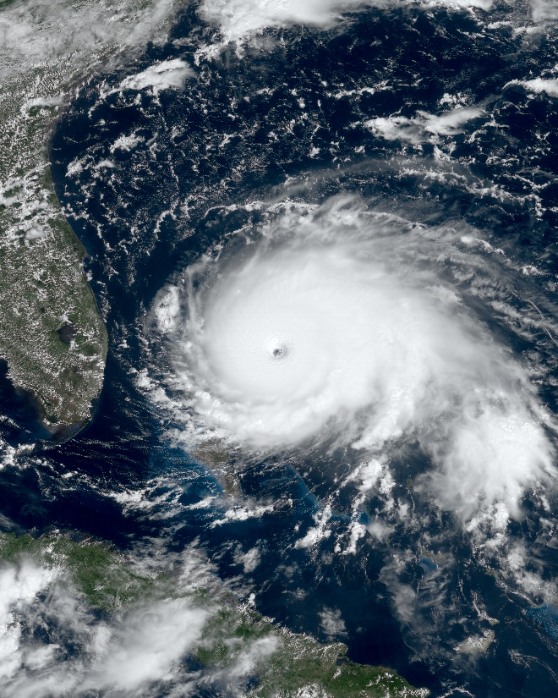
Considerations when Negotiating Terms
Insurance considerations
Only CIP and CIF require insurance (and CIF is a vessel-only provision)
Required insurance may not be adequate
If risk of loss remains with Seller during main carriage insurance may be less important (or they cover)
But what if you face penalties for non-performance?
What insurance does the carrier offer? Is it adequate?

Slide 33
Considerations when Negotiating Terms
Incoterms provisions allocate responsibilities for compliance/clearance under other laws, including export, import, duties/tariffs, and taxes
Review the terms to make sure you understand your responsibilities
Take compliance and costs into account when negotiating price and responsibilities
You are not limited to the structure of the selected term
Add or waive requirements, but make sure it is clear
Engage an attorney for assistance if revising or amending Incoterm requirements

Slide 34
Final Thoughts
Be careful when using standard forms and boilerplate
Regularly review your standard terms & conditions and commercial documents to make sure they don’t include unexpected provisions or terms that needlessly waive your rights
Build processes to review risk as part of your contracts
Have different forms for different facts
Contracts don’t matter until they matter – be sure you will be protected when things go wrong
Consult with an attorney to cover the details

Slide 35
Questions?
Please feel free to ask questions

Slide 36
Thank You
Jason Dickstein
Aviation Suppliers Association General Counsel
Washington Aviation Group
2233 Wisconsin Avenue, Suite 503
Washington, DC 20007
Tel: (202) 628-6776
Jason@WashingtonAviation.com

Slide 37
Maritime-Only Incoterms

Slide 38
Free Alongside Ship (FAS)
Seller responsibilities
Deliver goods alongside vessel prepared for shipment
Clear goods for export
Buyer responsibilities
Risk transfers when goods are laid alongside vessel
Loading vessel
All fees, duties, compliance
Insurance: Seller is not obligated to insure goods

Slide 39
Free on Board (FOB)
Seller responsibilities
Load goods on vessel
Clear goods for export
Buyer responsibilities
Risk transfers when goods are loaded on vessel
All fees, duties, compliance
Insurance: Seller is not obligated to insure goods

Slide 40
Cost and Freight (CFR)
Seller responsibilities
Arranges and pays for transportation
Load goods on vessel
Clear goods for export
Buyer responsibilities
Risk transfers when goods are loaded on vessel
Import fees and duties
Insurance: Seller is not obligated to insure goods

Slide 41
Cost Insurance and Freight (CIF)
Seller responsibilities
Arranges and pays for transportation
Load goods on vessel
Clear goods for export
Buyer responsibilities
Risk transfers when goods are loaded on vessel
Import fees and duties
Additional insurance if required insurance inadequate
Insurance: Seller must also insure goods
300 Massachusetts Ave NW, Washington, D.C. 20001

