Slide 1
Introduction to Export Compliance
Monday, August 31st, 2026
Presented by
Jason Dickstein, ASA General Counsel

Slide 2
What is an Export?
Actual shipment or transmission of items out of the U.S.
  Includes software
  Includes technology (e.g. technical data and other visible information)
  Can include technical documents, like CMMs or service bulletins, in some cases
  Includes repaired items that are being returned!
Deemed export
  Any release in the United States of “technology” or source code to a foreign person
  “Deemed” exported to the country of citizenship or permanent residency
Transit through a country is considered an export to that destination, too
NOTE: Re-exports (beyond the US) and in-country transfers are also typically regulated

Slide 3
Three Important Export Regulators in the US
BIS – Bureau of Industry and Security
  Commerce Department office responsible for the regulation of most exports
DDTC – Directorate of Defense Trade Controls
  State Department office responsible for the regulation of exports of defense-related articles
OFAC - Office of Foreign Asset Control
  Treasury Department office responsible for certain additional export controls meant to advance particular interests of the United States

Slide 4
Steps to Compliance
Treasury Restrictions
BIS v. DDTC
Destination Restrictions
Party Restrictions
Other Regulatory Issues (like use restrictions)
Obtain Licenses
EEI
Export!
Look at Treasury restrictions
Identify whether the article is State or Commerce restricted
Examine appropriate destination restrictions
Check party-level restrictions
Identify other regulatory issues
Obtain licenses as necessary
Document the transaction

Slide 5
First, Can I Transact Business Here At All?
Are there General Treasury
Restrictions that Regulate
Transfer of Assets?

Slide 6
OFAC Lists
Sanctions Programs List:
  https://ofac.treasury.gov/sanctions-programs-and-country-information
  Typically directed at countries, but may also serve more targeted purposes e.g., Counter Terrorism.
Specially Designated Nationals List:
https://sanctionssearch.ofac.treas.gov/ [Search Engine]
  https://home.treasury.gov/policy-issues/financial-sanctions/specially-designated-nationals-and-blocked-persons-list-sdn-human-readable-lists
Sectoral Sanctions List
  https://www.treasury.gov/ofac/downloads/ssi/ssilist.pdf
These lists change, and entities can move from one list to another, so do the search every time!

Slide 7
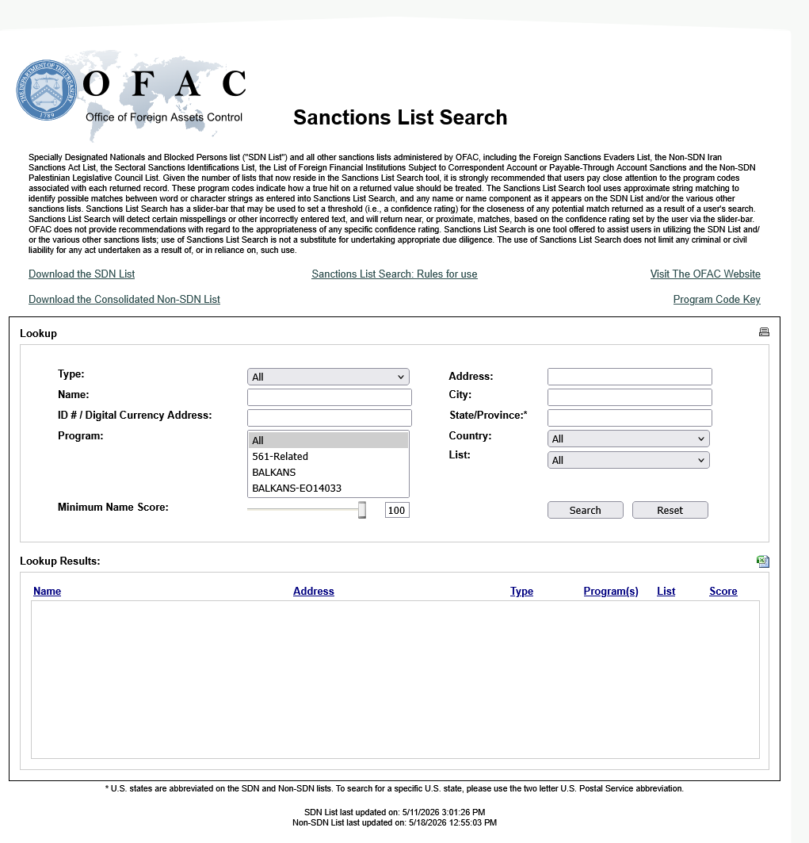
https://sanctionssearch.ofac.treas.gov/

Slide 8
Consolidated Screening List
Commerce, State, and Treasury lists
https://www.trade.gov/data-visualization/csl-search
“Best Practice” – if you can automate your CRM system so that it automatically checks daily against the consolidated list, then you will know when business partners are added to the system and can manage those relationships
If you have problems using the consolidated list, then use the individual lists
Please note that lists and regulations are updated frequently by the government, and should be checked for each transaction

Slide 9
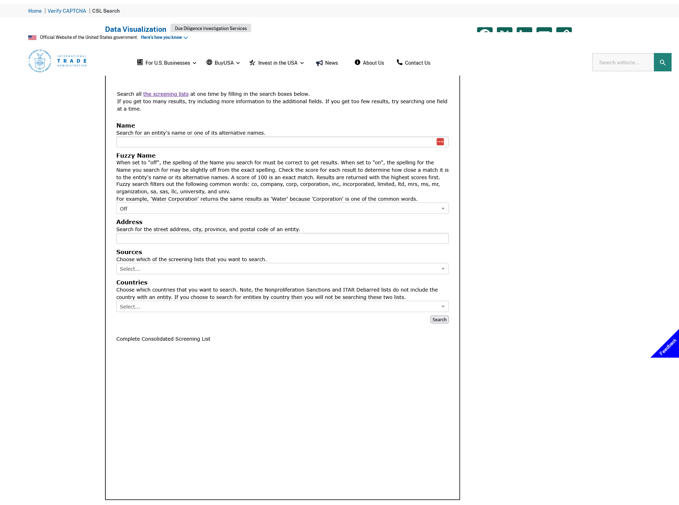

Slide 10
Sample Sanctioned Parties as of May 25, 2025
A Level Aero Systems
Aero Continent
Aero Courier Cargo
Aero Express Intercontinental
Aero Sky One
Aeroatlantico
Aerocaribbean Airlines
Aerocomercial Alas De Colombia
Aeromax
Aeronautica Condor
Aerospace Industries Organization
Aerospace Research Institute
Aerovias Atlantico Ltda
AFAGIR
Air Alanna
Air Koryo
Aircraft Avionics Parts and Support Ltd
Airfix Aviation OY
Al-Naser Airlines
Avia Group LLC
Avia Import
Avia Trust FZE
Aviacon Air Cargo
Aviation Capital Solutions, Ltd
Blue Sky Aviation
Butembo Airlines
Capacitacion Aeronautica Profesional
Caspian Airlines
Cham Wings Airlines
Cubana Airlines
Dart Airlines
Dena Airways
Empresa Cubana de Aviacion
Fars Air Cargo Airline
Hors Airlines Ltd
Intercontinental de Aviacion
Int’l Airline Consulting
Iran Air
Kyrgyz Trans Avia Airlines
Mahan Air
Mantenimiento, Aeronautica, Transporte, Y Servicios Aereos
Pouya Airlines
Sky Blue Airlines
Syrian Air Force Intelligence
Syrian Airlines
TAE Avia
Yasair Cargo Airline

Slide 11
Sectoral Sanctions and Specially Designated Nationals (SDNs) Lists
Persons on the Sectoral Sanctions List or the Specially Designated Nationals (SDNs) List are blocked
Blocked:
  a U.S. person may not procure goods, services, or technology from, or engage in transactions with, a blocked person directly or indirectly (including through a third-party intermediary)
  This typically means no exports and no imports with blocked parties
  It also means no acceptance of funds from (or payments to) a blocked party
  In all cases, an OFAC license can help overcome these impediments

Slide 12
Can I sell to a Subsidiary?
ISSUE: The parent company is on the OFAC sanctions list, but the subsidiary is not. Can I sell to the subsidiary?
If a blocked person owns or controls another entity, then that entity is blocked as well
  Example: Rostec was sanctioned under the Ukraine/Russia related sanctions in 2014. They own most of United Engine Corp. United Engine Corp. was not on the OFAC sanctions list, but it was still treated as a blocked party because of the ownership.
  NOTE: United Engine Corp. was added two years later; United Engine Corp. is also on the BIS entity and MEU lists.
If two or more blocked persons own 50% or more of another entity, then the owned entity is also blocked (substantial control is assumed)

Slide 13
OFAC Sanctions Programs by Country
Current as of May 18, 2026
Afghanistan
Balkans
Belarus
Burma (Myanmar)
Central African Republic
China (incl. Hong Kong)
Congo (Dem. Rep.)
Cuba
Ethiopia
“The International Criminal Court”
Iran
Iraq
Lebanon
Libya
Mali
Nicaragua
North Korea
Russia
Somalia
Sudan and Darfur
South Sudan
Syria (changed to Assad and related parties in 2025)
Ukraine/Crimea/Russia
Venezuela
Yemen
Most of these programs authorize sanctions against person and/or entities, which is why it is so important to check for sanctioned business partners
Notes:
Balkans Sanctions05/22/2006 Belarus Sanctions06/19/2006 Burma Sanctions 05/22/2006 Cote d'Ivoire (Ivory Coast) 02/08/2006 Cuba Sanctions 02/22/2005 Iran Sanctions05/22/2006 Iraq Sanctions07/21/2005 Liberia Sanctions04/26/2005 North Korea Sanctions04/06/2006 Sudan Sanctions05/22/2006 Syria Sanctions05/22/2006 Zimbabwe Sanctions05/22/2006

Slide 14
Exception: Treasury Licenses
A general OFAC license authorizes certain transactions without the filing of an application with OFAC
  Example: Russia general license 40B permits exporting aircraft parts to certain Russian manufacturers/lessors for their civil aircraft registered outside of Russia
A specific OFAC license is issued on a case-by-case basis, and authorizes an activity that would otherwise be prohibited by the embargo or sanctions program
  Example: 31 C.F.R. § 560.528 permits licenses on a case-by-case basis to support safety of civil aviation

Slide 15
Practical Advice – OFAC Compliance
Gather information – do not be willfully blind to the facts
Consider ownership interests and flow-down of sanctions
Always check your export business partners on the consolidated screening list and the OFAC sanctions list for every transaction
If you identify a party who appears to be blocked, then do not engage in any transaction without first identifying your compliance path
  Consult with a lawyer!
  Remember that there may be a compliance path, including through licensing, if the proposed transaction does not conflict with U.S. interests

Slide 16
Steps to Compliance
Treasury Restrictions
BIS v. DDTC
Destination Restrictions
Party Restrictions
Other Regulatory Issues (like use restrictions)
Obtain Licenses
EEI
Export!
Look at Treasury restrictions
Identify whether the article is State or Commerce restricted

Slide 17
Distinguishing the Primary Agency With Export Jurisdiction
Distinguish the U.S. Department with jurisdiction
  Is it a US Munitions List Item?
    Defense articles (many dual-use items have been removed from the USML)
    Check ITARs
    State has export jurisdiction
  Otherwise subject to BIS restrictions
    Identify the ECCN
    Check BIS export administration regulations
    Commerce has export jurisdiction
ITAR
EAR

Slide 18
Most Civil Aircraft Parts ARE NOT Covered Under the ITARs
Effective October 15, 2013 many aircraft articles were removed from the ITAR and moved into the Commerce Department’s regulations
  Most dual use items were transferred to Commerce
  Transferred items typically were assigned to “600” series ECCNs
  This is for parts and articles; most completed defense aircraft remain on the USML and are subject to ITAR
This was accomplished across the USML in the 2012-2013 timeframe

Slide 19
Examples of USML Aircraft Articles
Certain articles (and their subcomponents) that are specially designed for USML/9A610-controlled aircraft:
    Inertial Navigation Systems (INS)
    Inertial Measurement Units (IMUs)
    Attitude and Heading Reference Systems (AHRS)
  Parts for DoD-funded developmental aircraft
  Parts for B-1B, B-2, B-21, F-15SE, F/A-18E/F/G [parts for earlier models are subject to the EAR], F-22, F-35, F-117
  Parts found in a positive list
    Published at 22 C.F.R. 121.1 - VIII(h)
    Articles with defense-specific purposes, like threat-adaptive flight control systems, wing folding systems, etc.

Slide 20
What if it is DDTC-Controlled?
First, register with DDTC
Second, obtain Licenses
  There are some license exceptions but most DDTC-controlled transactions require a license

Slide 21
Export Compliance for BIS-Controlled Articles
Most civil aircraft parts transactions are controlled under the BIS regulations

Slide 22
Is it Regulated by the Commerce Department?
What am I exporting? Is it classified under the Commerce Control List (CCL)?
  https://www.bis.doc.gov/index.php/regulations/commerce-control-list-ccl
Examples:
  CCL 2 - Material processing (e.g., bearings, certain testing equipment, etc.)
  CCL 3 - Electronics
  CCL 7 - Avionics
  CCL 9 - Aerospace and Propulsion

Slide 23
Export Control Classification Numbers (for items on the CCL)
Determine ECCN
  Peruse the CCLs for ECCNs that describe your export
  Alphabetical index to the CCL provides some help:
  https://www.bis.doc.gov/index.php/documents/regulations-docs/13-commerce-control-list-index/file
  Ask the manufacturer
  Online via the Simplified Network Application Process:
  https://www.bis.doc.gov/index.php/licensing/simplified-network-application-process-redesign-snap-r

Slide 24
Some Common Aviation ECCNs
7A103
7A994
9A610
9A619
9A991
Certain Inertial Reference Units
Certain Avionics
Certain Articles for Defense Airframes
Certain Articles for Defense Engines
Certain Articles for Commercial Aircraft

Slide 25
Export Control Classification Numbers
General item default for unlisted articles is EAR99
  But aircraft part default is 9A991 when the part is “specially designed” for civil aircraft
  Many avionics default to 7A994
  Civil avionics calibration and test equipment tends to be 7B001 or 7B994
If it is not in the CCL (e.g. if it is EAR99), then a license may be unnecessary to most destinations
  But certain limits like sanctions, denied parties or a controlled usage may still impose licensing obligations

Slide 26
Steps to Compliance
Treasury Restrictions
BIS v. DDTC
Destination Restrictions
Party Restrictions
Other Regulatory Issues (like use restrictions)
Obtain Licenses
EEI
Export!
Look at Treasury restrictions
Identify whether the article is State or Commerce restricted
Examine appropriate destination restrictions

Slide 27
Destination Restrictions
The reasons for control associated with the ECCN identify destination restrictions.
Exports to certain destinations may require a license; if the policy is to deny licenses, then this may be a de facto prohibition on exports.
We use the Commerce Control List ECCN and the cross-referenced Commerce Country Chart to determine reasons for control (e.g., NS1, RS1) which can lead to license requirements

Slide 28
Finding the Resources
Commerce Control List (CCL)
Supplement No. 1 to Part 774
https://www.ecfr.gov/current/title-15/subtitle-B/chapter-VII/subchapter-C/part-774/appendix-Supplement%20No.%201%20to%20Part%20774
Commerce Country Chart
Supplement No. 1 to Part 738
https://www.ecfr.gov/current/title-15/part-738/appendix-Supplement%20No.%201%20to%20Part%20738

Slide 29
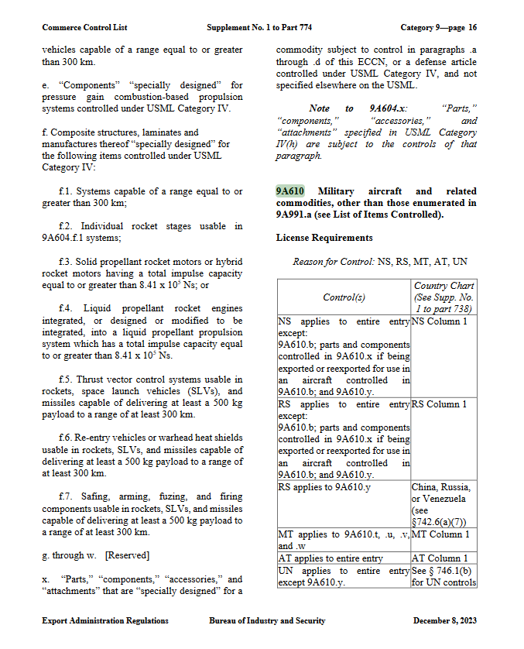

Slide 30
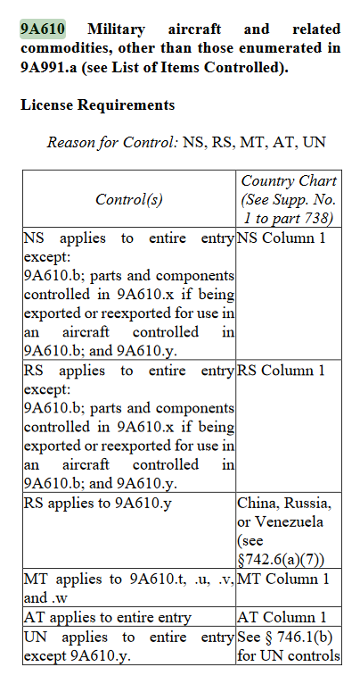
Reasons for control
  NS: National Security
  RS: Regional Stability
  MT: Missile Technology
  AT: Anti-Terrorism
  UN: UN Sanctions

Slide 31
Do You Need a Commerce Department License?
Check the specific reasons for control in CCL. Read it in its entirety; some reasons for control have special provisions or restrictions.
Check the Commerce Country Chart (cross reference country against the reason for control):
  https://www.ecfr.gov/current/title-15/subtitle-B/chapter-VII/subchapter-C/part-738/appendix-Supplement%20No.%201%20to%20Part%20738
  If there is an “X” in the cross-reference, then you need a BIS license (or license exception) for export
  Also be sure to read the notes when indicated by a superscripted number after the country name
Notes:
The Export Control Country Chart is found at 15 C.F.R. Part 738 Supp. 1

Slide 32
Hypothetical
We are exporting two sets of identical aircrew safety equipment controlled under 9A610.g
  Reasons for control?
One set is going to Afghanistan
One set is going to Australia
Do we need licenses based (solely) on destination?

Slide 33
9A610.g reasons for control
  NS: National Security (applies)
  RS: Regional Stability (applies)
  MT: Missile Technology (not to 9A610.g)
  AT: Anti-Terrorism (applies)
  UN: UN Sanctions (doesn’t apply to Australia nor Afghanistan, we’ll get to that list in a moment)

Slide 34
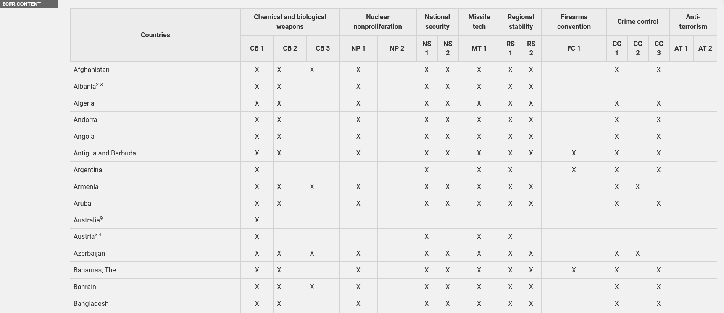

Slide 38
Answers
We are exporting two sets of identical aircrew safety equipment controlled under 9A610.g
  Reasons for control: NS1, RS1, AT1
One set is going to Afghanistan – needs a license based on destination country
One set is going to Australia – no license needed based on destination country

Slide 39
UN Destination Restrictions
Articles controlled for reason “UN” are restricted from export to the Central African Republic, Democratic Republic of the Congo, Eritrea, Iran, Iraq, Lebanon, Libya, North Korea, Somalia, and Sudan due to UN Security Council arms embargoes (15 C.F.R. § 746.1(b)(2))
Demilitarized aircraft [9A991.a] are an example of something subject to “UN” controls

Slide 40
Steps to Compliance
Treasury Restrictions
BIS v. DDTC
Destination Restrictions
Party Restrictions
Other Regulatory Issues (like use restrictions)
Obtain Licenses
EEI
Export!
Look at Treasury restrictions
Identify whether the article is State or Commerce restricted
Examine appropriate destination restrictions
Check party-level restrictions

Slide 41
BIS Forbidden Parties
Department of Commerce’s Bureau of Industry and Security (BIS) lists:
  Denied Persons List
    https://www.bis.doc.gov/index.php/the-denied-persons-list
  Denied Entities List
    https://www.bis.doc.gov/index.php/policy-guidance/lists-of-parties-of-concern/entity-list
  You can also find them on the consolidated export screening list
    https://www.trade.gov/data-visualization/csl-search
NEW: BIS has started to add addresses to the denied entities lists
  Run your addresses through the consolidated list as well
Notes:
STANDARD DENIAL FORM:
[the denied person(s)] may not, directly or indirectly, participate in any way in any transaction involving any commodity, software or technology (hereinafter collectively referred to as "item") exported or to be exported from the United States that is subject to the Export Administration Regulations (EAR), or in any other activity subject to the EAR, including, but not limited to:
A. Applying for, obtaining, or using any license, License Exception, or export control document;
B. Carrying on negotiations concerning, or ordering, buying, receiving, using, selling, delivering, storing, disposing of, forwarding, transporting, financing, or otherwise servicing in any way, any transaction involving any item exported or to be exported from the United States that is subject to the EAR, or in any other activity subject to the EAR;
or
C. Benefiting in any way from any transaction involving any item exported or to be exported from the United States that is subject to the EAR, or in any other activity subject to the EAR.
SECOND, that no person may, directly or indirectly, do any of the following:
A. Export or reexport to or on behalf of the denied person any item subject to the EAR;
B. Take any action that facilitates the acquisition or attempted acquisition by a denied person of the ownership, possession, or control of any item subject to the EAR that has been or will be exported from the United States, including financing or other support activities related to a transaction whereby a denied person acquires or attempts to acquire such ownership, possession or control;
C. Take any action to acquire from or to facilitate the acquisition or attempted acquisition from the denied person of any item subject to the EAR that has been exported from the United States;
D. Obtain from the denied person in the United States any item subject to the EAR with knowledge or reason to know that the item will be, or is intended to be, exported from the United States; or
E. Engage in any transaction to service any item subject to the EAR that has been or will be exported from the United States and which is owned, possessed or controlled by a denied person, or service any item, of whatever origin, that is owned, possessed or controlled by a denied person if such service involves the use of any item subject to the EAR that has been or will be exported from the United States. For purposes of this paragraph, servicing means installation, maintenance, repair, modification or testing.
THIRD, that, after notice and opportunity for comment as provided in section 766.23 of the EAR, any person, firm, corporation, or business organization related to the denied person by affiliation, ownership, control, or position of responsibility in the conduct of trade or related services may also be made subject to the provisions of this order.
FOURTH, that this order does not prohibit any export, reexport, or other transaction subject to the EAR where the only items involved that are subject to the EAR are the foreign-produced direct product of U.S.-origin technology.

Slide 42
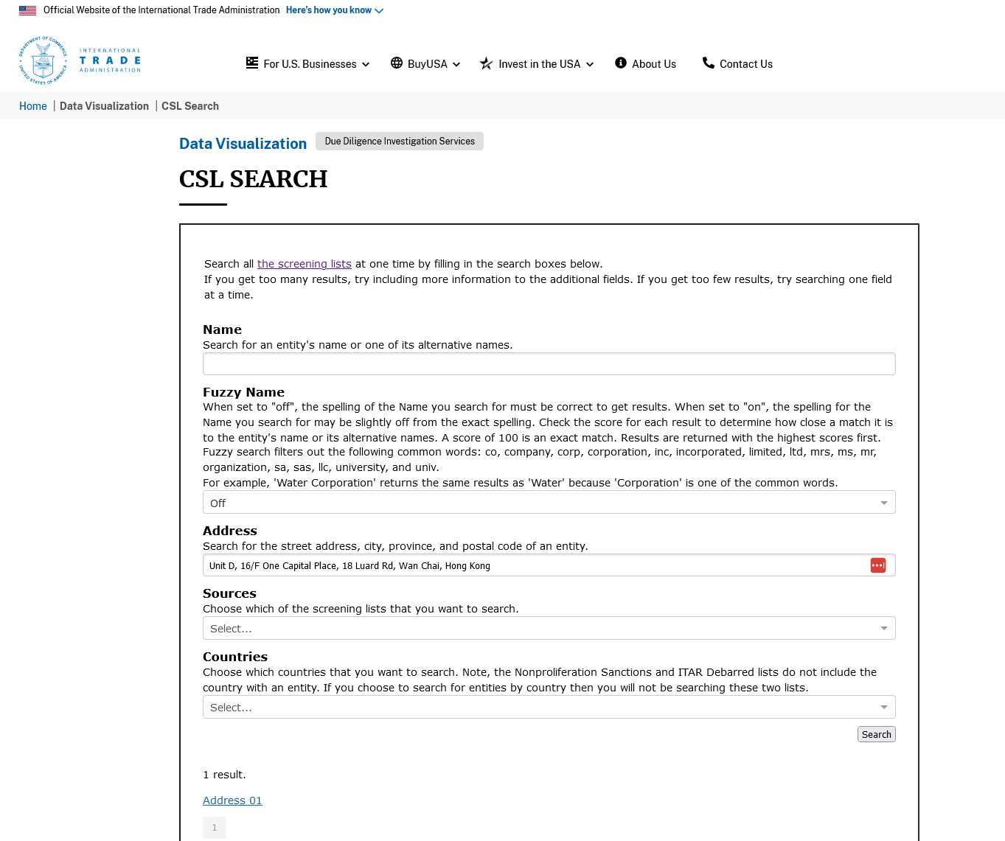
Leave “Name” blank
Set “Fuzzy Name” to ‘Off’
Plug-in the Address you want to check
Results

Slide 43
What Is Denied?
Denied Persons may NOT participate in any way in any transaction involving the export from the United States of any commodity, software or technology subject to Export Administration Regulations (EAR)
  No license transactions
  No negotiations
  No benefit from any export transaction
  May not be the principal nor the agent in an export transaction
  No facilitation of exports
  No facilitation of acquisition of an export item
  No procurement of items from the US for servicing
Pay special attention to Temporary Denial Orders
  Some businesses, including airlines, are subject to temporary denial orders that have a broader sweep and include acquisition limits as well as export limits

Slide 44
Temporary Denial Orders –
Pay Special Attention (Russia)
Rossiya Airlines
Siberian Airlines (S7)
Skywind International Limited
Ural Airlines
UTair Aviation
Aeroflot
Aviastar-TU
Azur Air
Belavia Belarusian Airlines
Nordwind Airlines
Pobeda Airlines

Slide 45
Temporary Denial Orders –
Not Just for Russia
Iran Air
Mahan Airlines (+ Qeshm Fars Air)
Kerman Aviation
Al Naser Airlines

Slide 46
Temporary Denial Orders –
Extended Application Can Include Imports
It is important to read the entire TDO
Acquisition of parts from TDO parties can be illegal
  Typically tied to exports due to the limits of BIS jurisdiction
    Parts previously exported
    Parts subsequently exported
    Parts intended to be exported
  There is an opportunity to obtain a license to support flight safety, but even then, the license is needed
Providing services to TDO parties can be illegal
  This can include maintenance on parts owned by a TDO

Slide 47
Steps to Compliance
Treasury Restrictions
BIS v. DDTC
Destination Restrictions
Party Restrictions
Other Regulatory Issues (like use restrictions)
Obtain Licenses
EEI
Export!
Look at Treasury restrictions
Identify whether the article is State or Commerce restricted
Examine appropriate destination restrictions
Check party-level restrictions
Identify other regulatory issues

Slide 48
Do You Need a Commerce Department License?
What will the importer do with it? Certain end-uses are restricted:
  See 15 C.F.R. Part 744
  Rocket systems and certain unmanned air vehicles may require licensing; certain military end-users and/or end-uses may also be restricted
  These restrictions may drive a need to check third party country of registry and control (see “where is it going”)
  § 744.7 requires us to identify the country in which an aircraft is located, is registered, and is controlled.
What else does the receiver do? Certain types of conduct are prohibited without BIS license
  Supporting design, development or production of missiles or nuclear explosive devices or chemical weapons or biological weapons
  Supporting (through financing or logistics) a transaction that would violate the licensing provisions if performed, directly
Who will receive it? Check the BIS prohibition lists

Slide 49
Parts for Foreign Aircraft
General Rule for Foreign Aircraft (15 C.F.R. § 744.7)
In addition to the normal license requirements, we may not export an aircraft part subject to the export administration regulations for use on a foreign aircraft, unless a License Exception or NLR permits the shipment to be made:
  To the country in which the aircraft is located, and
  To the country in which the aircraft is registered, and
  To the country, including a national thereof, which is currently controlling, leasing, or chartering the aircraft

Slide 50
Some Parts of the World are Subject to Special Controls
For example (not a complete list!):
Belarus (15 C.F.R. §§ 744.21, 746.5, 746.8, 746.10)
Burma (15 C.F.R. § 744.21)
Cambodia (15 C.F.R. § 744.21)
China (15 C.F.R. § 744.21)
Crimea and other regions of Ukraine (15 C.F.R. § 746.6)
Cuba (15 C.F.R. § 746.2)
Iran (15 C.F.R. § 746.7)
Iraq (15 C.F.R. § 746.3)
North Korea (15 C.F.R. § 746.4)
Russia (15 C.F.R. §§ 744.10, 744.21, 746.5, 746.8, 746.10)
Syria (15 C.F.R. § 746.9)
Venezuela (15 C.F.R. § 744.21)

Slide 51
Combining the Foreign Aircraft Rule (§ 744.7) with the Russia Rule (§ 746.8):
We may not export an aircraft part subject to the EAR for use on a foreign aircraft,
  If the aircraft is located in Russia, or
  If the aircraft is registered in Russia, or
  If the aircraft is controlled, leased, or chartered by Russia or a national of Russia;
unless the export is covered by a license or a license exception.
This is a special concern right now, because of the efforts to circumvent the Russia sanctions
  This is creating a special need for assessment of transactions

Slide 52
General Prohibition
BIS has published ten general prohibitions (15 C.F.R. § 736.2)
General Prohibition 10 makes it illegal to engage in a transaction (including a domestic sale) if you know that an export violation has occurred, is about to occur, or is intended to occur
  No license exception applies
Don’t allow yourself to be willfully ignorant: the government may apply a “knew or reasonably should have known” standard

Slide 53
Steps to Compliance
Treasury Restrictions
BIS v. DDTC
Destination Restrictions
Party Restrictions
Other Regulatory Issues (like use restrictions)
Obtain Licenses
EEI
Export!
Look at Treasury restrictions
Identify whether the article is State or Commerce restricted
Examine appropriate destination restrictions
Check party-level restrictions
Identify other regulatory issues
Obtain licenses as necessary

Slide 54
Do You Need a BIS License?
BIS Licenses:
  A relatively small percentage of total US exports and re-exports require a BIS license
  Licenses can be used to overcome exclusions
Apply for licenses using SNAP-R
There are several very useful license exceptions, such as AVS and RPL
Notes:
Have a hand out of the specifics of each step for determining whether a BIS license is needed.

Slide 55
Steps to Compliance
Treasury Restrictions
BIS v. DDTC
Destination Restrictions
Party Restrictions
Other Regulatory Issues (like use restrictions)
Obtain Licenses
EEI
Export!
Look at Treasury restrictions
Identify whether the article is State or Commerce restricted
Examine appropriate destination restrictions
Check party-level restrictions
Identify other regulatory issues
Obtain licenses as necessary
Document the transaction

Slide 56
Don’t Forget the “Paperwork”
Place a destination control statement on your commercial invoice
Electronic Export Information
  Must be filed on-line: https://ace.cbp.dhs.gov
  You will get an International Transaction Number (ITN)
    Comes in your responsive email – also found in ACE Shipment Manager
    ITN goes on 1st page of the commercial loading document (e.g. air waybill, bill of lading)
  There is a limited exception for non-licensed commodities valued at less than $2,500 (per schedule B number)
Document retention period is five years (keep all transactional documents)
If you are shipping through a freight forwarder, then absent a special agency agreement, you are usually expected to file the EEI

Slide 57
Statement on the Commercial Invoice
Destination Control Statement (identical to the ITAR statement)
  “These items are controlled by the U.S. government and authorized for export only to the country of ultimate destination for use by the ultimate consignee or end-user(s) herein identified. They may not be resold, transferred, or otherwise disposed of, to any other country or to any person other than the authorized ultimate consignee or end-user(s), either in their original form or after being incorporated into other items, without first obtaining approval from the U.S. government or as otherwise authorized by U.S. law and regulations.”
  Include the statement on the commercial invoice
    For “600 series” articles, also include the ECCN

Slide 58
Routed Exports
What if you have a domestic shipment that you know will be subsequently exported?
  E.g. because a foreign buyer had it shipped to their freight forwarder or other authorized agent
A routed export transaction is “a transaction in which the FPPI authorizes a U.S. agent to facilitate export of items from the United States on its behalf and prepare and file the EEI.”
USPPI must provide a shipper’s letter to the authorized agent:
(i) Name and address of the USPPI.
(ii) USPPI Identification Number (this can be your EIN or it can be a unique exporter number assigned by CBP)
(iii) U.S. State of origin [postal code for where the good start their journey]
(iv) FTZ if applicable.
(v) Commercial description of commodities.
(vi) Origin of goods indicator: Domestic (D) or Foreign (F).
(vii) Schedule B or HTSUS, Classification Commodity Code.
(viii) Quantities/units of measure.
(ix) Value.
(x) Export Control Classification Number (ECCN)
(xi) All licensing information including license exception
(xii) Any information that we know that may affect the determination of license authorization

Slide 59
Thank You
Jason Dickstein
Aviation Suppliers Association General Counsel
Washington Aviation Group
2233 Wisconsin Avenue, Suite 503
Washington, DC 20007
Tel: (202) 628-6776
Jason@WashingtonAviation.com

