Slide 1
Tariffs & Imports: What’s New in U.S. Imports for Aviation Parts
Monday, August 31st, 2026
Presented by
Jason Dickstein, ASA General Counsel
Attorney, Washington Aviation Group

Slide 2
WARNING
Tariffs are still subject to rapid change
Current changes to tariffs are often not well-telegraphed
The information in this presentation may become outdated, so it is important to always check the current regulations and HTSUS and ensure you are relying on the most current version of the law

Slide 3
Today’s Agenda
Proper classification of aircraft parts under tariff schedules
How to calculate duties
Chapter 98 Exceptions
  Goods temporarily imported for repairs
  US goods, returned
Current chapter 99 duty rates
  Country-specific tariffs
  Steel/aluminum tariffs

Slide 4
Harmonized Tariff Schedule of the United States (HTSUS)
https://hts.usitc.gov

Slide 5
It All Starts With a Tariff Code
Example: 8807.30.0030 [civil aircraft parts, not otherwise classified (NOT propellers and NOT undercarriages)]
Category = 8807.30.0030
Heading = 8807.30.0030
Subheading = 8807.30.0030
Statistical Suffix = 8807.30.0030

Slide 6
Classifying Aircraft Parts
8807 is a default heading for aircraft parts
Not every aircraft part is covered under 8807
Many aircraft parts are covered under other tariff codes
  Some gain the benefit of the Agreement on Trade in Civil Aircraft
  Some are outside the scope of the Agreement on Trade in Civil Aircraft
The Agreement on Trade in Civil Aircraft forbids duties on aircraft and their parts
  But has a list of exceptions, including hardware

Slide 7
Aircraft Parts that are Not Aircraft Parts
Articles that are excluded from the Agreement on Trade in Civil Aircraft may be subject to basic import duties, even if they are intended for installation on an aircraft
  Also typically subject to the 10% section 122 tariff
Examples:
  HTSUS 5806.10.24 Fabric tapes: 7% duty rate
  HTSUS 7007.11.00 Safety glass windshield: 5.5% duty rate
  HTSUS 7318.15.80 Stainless steel socket screws with shank diameter 6mm or more: 8.5% duty rate
  HTSUS 7318.24.00 Stainless steel cotter pins: 3.8% duty rate
  HTSUS 7616.10.30 Aluminum rivets: 4.7% duty rate

Slide 8
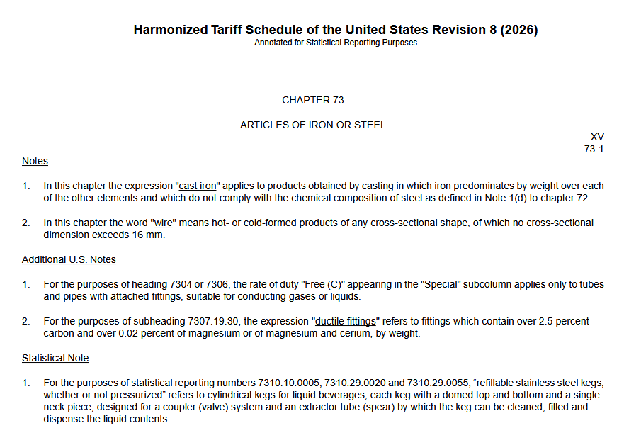

Slide 9
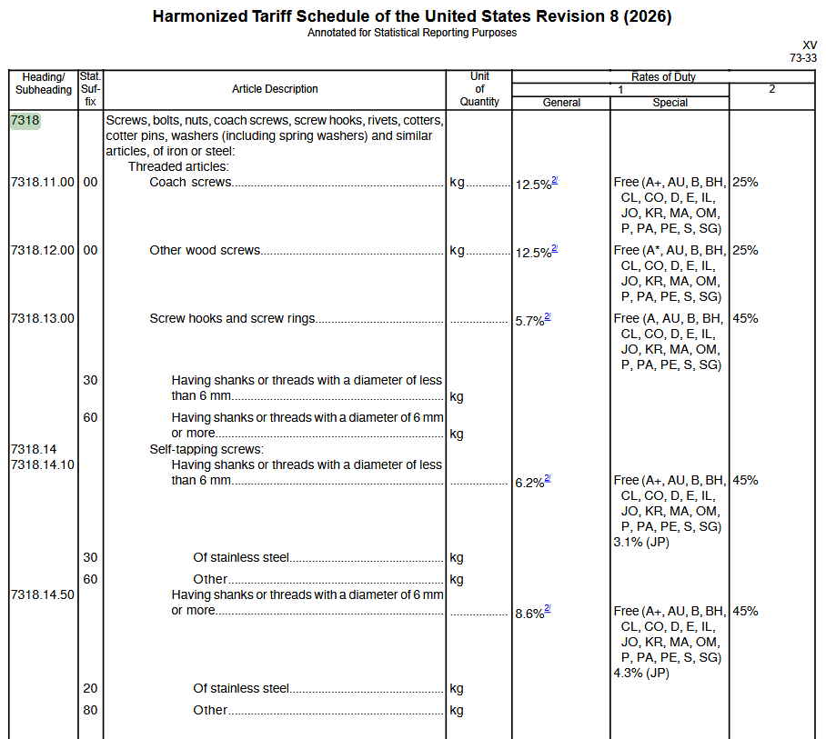

Slide 11
Sample Aircraft Parts (NOT a Complete List) for illustration purposes only - descriptions may be incomplete
3917.21.00
3917.22.00
3917.23.00
3917.29.00
3926.90.45
4009.12.00
4823.90.20
6812.80.90
Tubes/pipes/hoses made from ethylene polymer
Tubes/pipes/hoses made from propylene polymer
Tubes/pipes/hoses made from vinyl Cl⁻ polymer
Tubes/pipes/hoses made from other plastics
Plastic gaskets, washers and other seals
Tubes/pipes/hoses of rubber w/ fittings
Certain paper mache items
Certain parts made from crocidolite (asbestos)

Slide 12
Sample Aircraft Parts (NOT a Complete List) for illustration purposes only - descriptions may be incomplete
6813.20.00
6813.81.00
7007.21.11
7304.31.30
7312.10.05
7324.10.00
7413.00.90
7608.20.00
8108.90.60
Civil aircraft brake pads with asbestos
Civil aircraft brake pads without asbestos
Laminated safety glass windshield for aircraft
Tubes/pipes/hoses made from iron/nonalloy steel
Stainless steel stranded wire w/ fittings
Stainless steel sinks
Copper stranded wire w/ fittings
Tubes/pipes made from aluminum alloy
Tubes/pipes made from titanium w/ fittings

Slide 13
Sample Aircraft Parts (NOT a Complete List) for illustration purposes only - descriptions may be incomplete
8302.49.80
8407.10.00
8409.10.00
8411.22.40
8413.30.90
8414.10.00
8415.10.60
8419.50.10
Aircraft fittings
Reciprocating aircraft engines
Parts for reciprocating aircraft engines
Aircraft turboprop engines (exceeding 1,100 kW)
  There are many different engine codes
  The turbine engine codes will include parts
Fuel pumps
Vacuum pumps
Reversible heat pumps
Brazed aluminum plate-fin heat exchangers

Slide 14
Sample Aircraft Parts (NOT a Complete List) for illustration purposes only - descriptions may be incomplete
8421.21.00
8421.23.00
8424.10.00
8425.11.00
8471.41.01
8479.89.10
8483.10.10
8483.30.40
Water filters
Fuel filters
Fire extinguishers
Electric motor hoists
Certain computers
Air humidifiers or dehumidifiers
Internal combustion crankshafts
Certain bearings

Slide 15
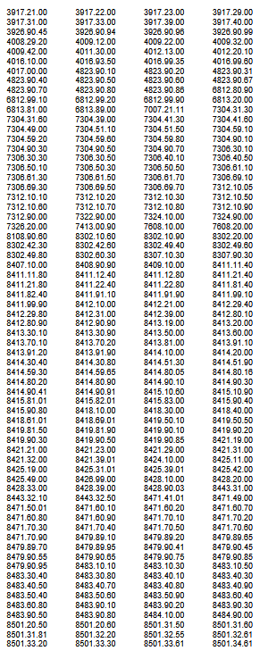
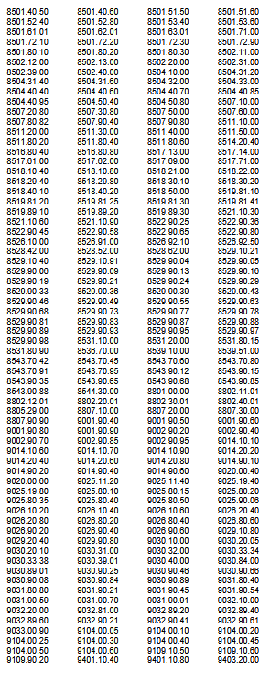

REALLY – It is NOT a Complete List
553 separate HTSUS Tariff Codes designated as aircraft parts codes that are potentially free from chapter 99 duties for certain countries
Over 19,000 HTSUS Tariff Codes, total (varies as codes are added or removed)

Slide 16
Identify the Right HTSUS Classification
Check Specific "Parts" Headings First: Start with the article’s description and look for specific, named parts provisions
  HTS.ITS.GOV has a search engine
Apply General Rules of Interpretation (GRIs) to “break ties”
General-Use Items: Hardware items (screws, seals) are often classified by material rather than the machine they fit (iron, steel, aluminum, etc.)
Other CBP Resources: Search the CROSS database for prior rulings
Document Your Classification Decision: Maintain detailed documentation of your classification decision to support compliance; consider applying for a Binding Ruling for high-value or complex parts to mitigate liability

Slide 17
General Rules of Interpretation
What if there are two equally valid classifications?
Prefer a more specific heading over a general heading
Goods put up in sets for sale shall be classified as if they consisted of the material or component which gives them their essential character
When goods cannot otherwise be classified, they shall be classified under the heading which occurs last in numerical order among those which equally merit consideration
Notes:
GRI 3

Slide 18
Applying the Rules of Interpretation
Fiberglass (carbon/glass) fabric designed for use in aircraft laminates
Greater Specificity choice was between
  subheading HTSUS 6815.10.00: nonelectrical articles of graphite or other carbon; or
  Subheading HTSUS 7019.20.50: colored woven fabrics of glass fibers
Each specified one of the fibers but not the other, so each was equally specific
Notes:
CROSS: HQ 088363

Slide 19
Applying the Rules of Interpretation
Fiberglass (carbon/glass) fabric designed for use in aircraft laminates
Essential Character choice was between
  subheading HTSUS 6815.10.00: nonelectrical articles of graphite or other carbon; or
  Subheading HTSUS 7019.20.50: colored woven fabrics of glass fibers
Comparing metrics of mass and value yielded conflicting results
  Glass fibers comprise 68% of the weight of the fabric
  Carbon represents approximately 81% of the value of the fabric
Notes:
CROSS: HQ 088363

Slide 20
Applying the Rules of Interpretation
Fiberglass (carbon/glass) fabric designed for use in aircraft laminates
Heading Which Occurs Last choice was between
  subheading HTSUS 6815.10.00: nonelectrical articles of graphite or other carbon; or
  Subheading HTSUS 7019.20.50: colored woven fabrics of glass fibers
Heading 7019 occurs last in numerical order among those which equally merit consideration (as compared to heading 6815), so under the third rule we must choose heading 7019
Notes:
CROSS: HQ 088363

Slide 21
Rules of Interpretation: Packaging Identified in Entry Documents
One-time use packaging
  Cases specially shaped or fitted to contain specific goods shall be classified with such goods when of a kind normally sold with those goods
  Subject to the rule above, packing materials/containers entered with goods therein shall be classified with the goods if they are of a kind normally used for packing such goods
Multi-use packaging
  When such packing materials or packing containers are clearly suitable for repetitive use, you would identify the packaging separately, e.g.
    HTSUS 3923 plastic boxes or cases
    HTSUS 4202 trunks, bags, and cases of leather, plastic, or paperboard
    HTSUS 4415 wooden packagings
    HTSUS 4819 corrugated paperboard boxes
    HTSUS 7310 iron or steel tanks, drums, cans, etc.
    HTSUS 7612 aluminum tanks, drums, cans, etc.

Slide 22
Each Step is Potentially Separate
Step 1: identify the base tariff and the associated duty
  Step 1A: identify provisions that may exempt your import from duty
  Step 1B: identify chapter 98 provisions – special situations - that may impact duties
Step 2: identify the chapter 99 tariff(s) and the associated duty(ies)
  Step 2A: identify provisions that may exempt your import from the chapter 99 duties – this may be identified by a separate tariff number
  Step 2B: If you identified a chapter 98 special situation, then look at the interaction between any chapter 98 provisions and the chapter 99 tariffs to identify how the duties are affected

Slide 23
Tariffs for 2026
Chapter 99 is for temporary tariffs and additional tariffs
Chapter 99 is the home of many of the recent changes reflecting tariffs on goods of particular origins or particular materials (e.g. aluminum or steel)
Civil aircraft parts “shall be subject to the additional ad valorem rate of duty imposed by [chapter 99] except as provided in 9903.96.01 [UK] and 9903.96.02 [Japan] with respect to the Agreement on Trade and Civil Aircraft”
Most aircraft parts imports are still subject to chapter 99 as a default, so you may need to identify a specific exception

Slide 24
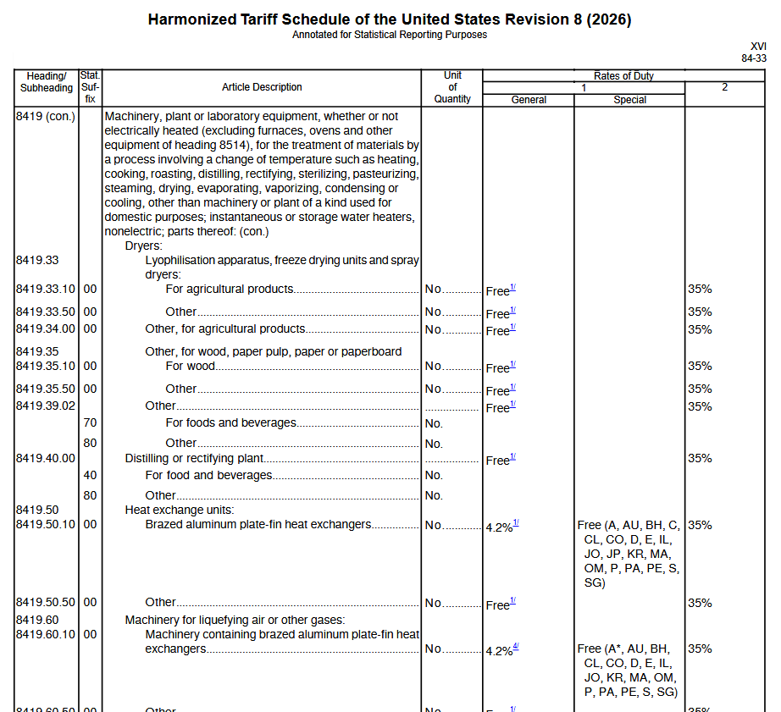
Tariff & Duty Example
8419.50.10: Brazed aluminum plate-fin heat exchanger
Subject to base duty of 4.2% if it is a non-aircraft part
  BUT that base duty is “free” if it is an aircraft part with proper paperwork
  The “free” element applies to duties found under chapters 1-98
Assume this is a product of the United Kingdom for purposes of this exercise
“C”

Slide 25
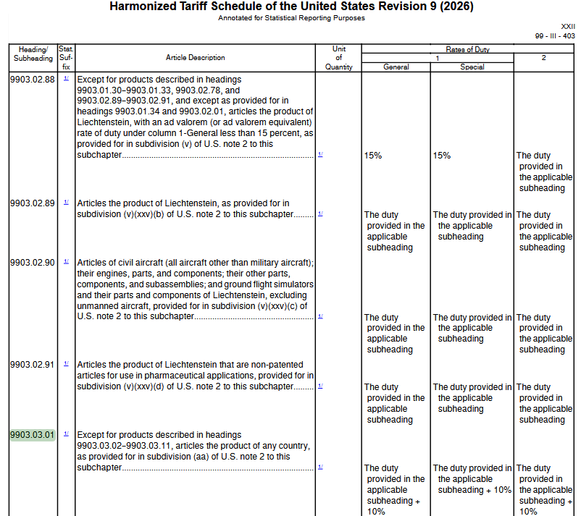
Expired Chapter 99 Tariff Status
9903.03.01: 10% tariff on most imported goods
  Promulgated in Proclamation 11012 (Feb. 20, 2026) for 150 days
Ruled Illegal (May 7, 2026) by the Court of International Trade
  But relief was only granted to the importer-plaintiffs!
  Currently on Appeal: Relief stayed June 11

Slide 26
Latest Chapter 99 Tariffs (under § 301)
Applied to 59 countries
Typically imposes 10% or 12.5% duty based on the country of origin
There is an aviation exception tariff (9903.05.88)
  Excludes the Section 301 (chapter 99) tariff
  This only applies to certain (listed) base codes (found in Chapter 99, subchapter III, U.S. note 52, subdivision (d))!
Algeria | Chile | Guyana | Kuwait | Pakistan | Switzerland
Angola | China | Honduras | Libya | Peru | Taiwan
Argentina | Colombia | Hong Kong, China | Malaysia | Philippines | Thailand
Australia | Costa Rica | India | Mexico | Qatar | Trinidad and Tobago
The Bahamas | Dominican Republic | Indonesia | Morocco | Russia | Türkiye
Bahrain | Ecuador | Iraq | New Zealand | Saudi Arabia | United Arab Emirates
Bangladesh | Egypt | Israel | Nicaragua | Singapore | United Kingdom
Brazil | El Salvador | Japan | Nigeria | South Africa | Uruguay
Cambodia | European Union | Jordan | Norway | South Korea | Venezuela
Canada | Guatemala | Kazakhstan | Oman | Sri Lanka | Vietnam

Slide 27
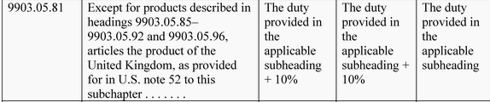
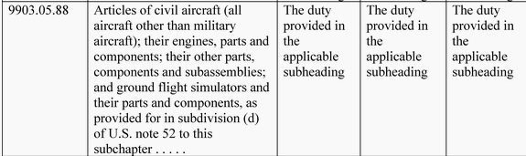
Parsing the Chapter 99 Tariffs
Chapter 99 duty for products of the United Kingdom is +10%
Aircraft parts with certain base tariff codes will be excluded from 9903.05.81

Slide 28
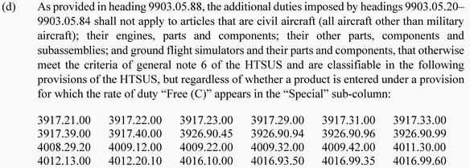
Is our heat exchanger included in the Note 52 exceptions?
Aircraft parts with certain base tariff codes will be excluded from 9903.05.81 by the exception code 9903.05.88
If you follow the lengthy list of codes in Note 52, then you will find that 8419.50.10 is listed

Slide 29
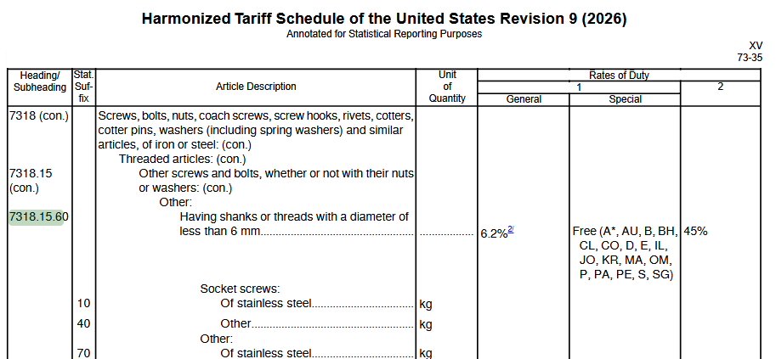
Example: Currently Subject to Chapter 99 Tariffs
Steel shear hex head bolt
7318.15.6070
Base duty is 6.2% - no “C”
This is NOT in the list of aircraft parts excepted by 9903.05.88
But it is a derivative steel product excepted by 9903.05.90 and subject to the steel tariff, instead
  Thus, the 10% duty of 9903.05.81 (or other comparable country-based tariff) does not apply
The derivative steel product duty does apply (9903.82.XX)
  US Note 16(c)(iv)
  10%-50% depending on details
  Total of 16.2%-56.2% duty
Notes:
HQ 088412, Proclamation 11012 (2026)

Slide 30
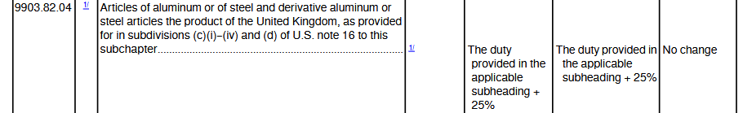
Example: Currently Subject to Chapter 99 Tariffs
Steel shear hex head bolt
  7318.15.6070
  Base duty is 6.2%
The derivative steel product duty does apply (9903.82.XX)
  US Note 16(c)(iv)
  +10%-50% depending on details
Assume these were products of the UK, and the steel was melted and poured in the UK
  HTSUS 9903.83.04
  +25% duty
  Total of 31.2%
Notes:
HQ 088412, Proclamation 11012 (2026)

Slide 31
Duty Mitigations Under Chapter 98 (for Aircraft Parts)

Slide 32
US Goods - Returned
Applies to products of the United States (be prepared to prove it is a product of the U.S.)
Also applies to foreign products that are returned to the U.S. within 3 years after having been exported from the U.S.
Tariff Codes:
  9801.00.10XX
  “XX” is replaced by a two-digit statistical reporting suffix tat corresponds to the chapter or heading fo the goods
    Example: U.S. aircraft parts subject to heading 8807 may be imported under 9801.00.1079
    Example: a U.S. engine part classified under heading 8411 could be imported under 9801.00.1035

Slide 33
Aircraft Parts Imported for Repair and Subsequent Export

Slide 34
Goods Temporarily in the United States (for repair, alteration or processing)
Goods may be entered temporarily under bond (TIB) [duty-free]
  The importer needs a bond
  The goods must be exported within a year, but this can be extended upon application
  If the aircraft part is installed on an aircraft and the aircraft leaves the United States, then this is an export that closes the TIB loop
Tariff Codes:
  9813.00.0520: articles being processed into goods produced in the U.S.
  9813.00.0540: articles being repaired or altered in the U.S.
  Enter the 9813.00.05XX tariff code followed by the underlying code of the goods (if it had not been classified under chapter 98)

Slide 35
Aircraft Parts Exported for Repair and Then Subsequently Imported back to the US

Slide 36
Goods that Temporarily left the United States (for repair or alteration)
On the way out, register serialized goods with CBP to identify them as U.S. sourced goods before they leave (CBP Form 4455)
Goods may be entered after repair
  Duty applies to the value of the repair or alteration
    NOT the full value of the goods
  Typically assessed based on invoice value, unless no charge was made or the invoiced value does not represent a reasonable value
Tariff Codes:
  9802.00.40XX: articles returned after warranty repair/alteration
    “XX” = “20” for internal combustion engines or “40” for other parts
  9802.00.50XX: articles returned after non-warranty repair/alteration
    “XX” = “30” for internal combustion engines, “60” for other parts, or “10” for a nexus to Caribbean Basin nations

Slide 37
Chapter 99 Still Applies to Some Chapter 98 Exceptions
Most chapter 98 provisions will exclude the additional Chapter 99 tariffs BUT certain foreign processing will still be subject to chapter 99 tariffs:
  9802.00.40 duty on the warranty repair value
  9802.00.50 duty on the repair cost
  9802.00.60 duty on the processing cost
  9802.00.80 duty on the full value of the article assembled abroad, minus the value of the products of the United States used in the assembly

Slide 38
Claiming Duty-Free Treatment for Aircraft Parts

Slide 39

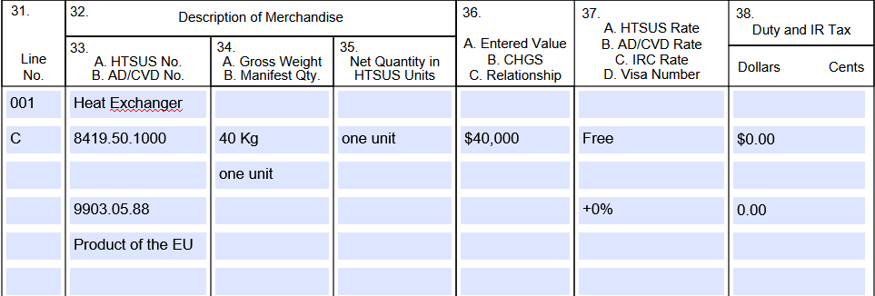
Claiming Duty-Free Treatment
First select a HTSUS Tariff Code that has “C” in the “Special Column
Place “C” on the entry summary
Identify the exception to the section 301 tariff from Chapter 99
19 C.F.R. § 10.183: Merchandise qualifying under paragraph (a) or paragraph (b) of this section is entitled to duty-free admission in accordance with General Note 6, HTSUS, upon meeting the requirements of this section. An importer will make a claim for duty-free admission under this section and General Note 6, HTSUS, by properly entering qualifying merchandise under a provision for which the rate of duty “Free (C)” appears in the “Special” subcolumn of the HTSUS and by placing the special indicator “C” on the entry summary.

Slide 40
Documenting Duty-Free Treatment
19 C.F.R. § 10.183
Must maintain evidence:
  The part is used as original or replacement equipment on civil aircraft
  Manufactured in accordance with US airworthiness law (including foreign parts acceptable to the FAA)
Documentation need not be filed with the entry summary
Documentation must be maintained in accordance with recordkeeping provisions
Documentation must be provided to government on demand
Possible evidence
An FAA certification (e.g. 8130-3)
Approval of airworthiness by an airworthiness authority in the country of export and evidence that the FAA recognizes that approval as an acceptable substitute for an FAA certification (e.g. EASA Form 1 and the FAA-EASA BASA Technical Implementation Procedures)
An application for a certification submitted to and accepted by the FAA (e.g. for a prototype part imported in support of a TC, TSOA or PMA program)
A type and production certificate issued by the FAA

Slide 41
Thank You
Jason Dickstein
Aviation Suppliers Association General Counsel
Washington Aviation Group
2233 Wisconsin Avenue, Suite 503
Washington, DC 20007
Tel: (202) 628-6776
Jason@WashingtonAviation.com

